Slide 1
IMR Process Improvement project
The current process required a massive overhaul to streamline the process of documenting and maintaining the characteristics of Bill of materials.
The major problem was that those characteristics were not important to any of the team members other than Procurement and Operations and thus asking other department users to fill in characteristics needs helps and bit of encouragement.

Slide 2
Current process
With the current process following team are involved
RnD
Marketing
Procurement
Operations
Finance
Quality
Regulatory

Slide 3
Current process Cont..
Data were collected at multiple deliverable.
Bill of materials
Multiple phases
Item masters
Multiple environments and warehouses
This made data redundancy
Lot of manual effort
Need to follow up
A huge margin for Human error
Leading to project delays by months
Change in one deliverables most of the time were not updated in other deliverables

Slide 4
New Process
The new process improvement project involved
A massive analysis of current business process
Lot of Interviews with end users to understand the pain points
Thinking over the design that would not only be a proof of concept but will also support future projects
Finding the boundary limits of project the cost and time feasibility
Determining the scope of project and limiting it to New product development

Slide 5
New Process Cont..
With new process
Create userforms to provide graphical way to collect data
Ask minimal number of questions to the user while building business logic using programming to automatically populate other fields
This reduced redundancy
Will save manual labor
Auto update any change in the Bill of Material and IMR without user knowing what they actually mean
Integrating different components of new product deliverables into one environment for easy access

Slide 6
New Process Step by Step
With the streamlining of process a workflow is created with following steps
Project Manager fill out form with project details and initiate the project
RnD starts building Bill of materials
Marketing adds any marketing material that may be needed
The list of items in bill of materials changes based on feedback from professional evaluation
Once Proof of design is finished, Manager would have the capability to lock the design to avoid any more addition or deletion of items and at the same time allowing user to update entries with automatic emails notification sent out with each change.
Procurement determine the type of materials the item fall into.
Based on the type of materials ( Make/Buy) operation team start providing details about warehouses and minimum safety stocks
Finance team would by that time be ready with all the code and will update respective fields
Quality and Regulatory would finalize the process with their entries

Slide 7
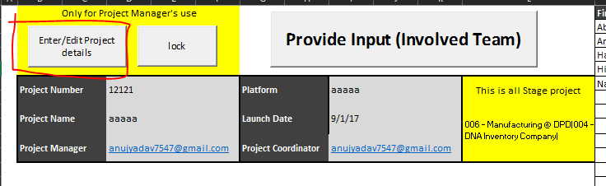
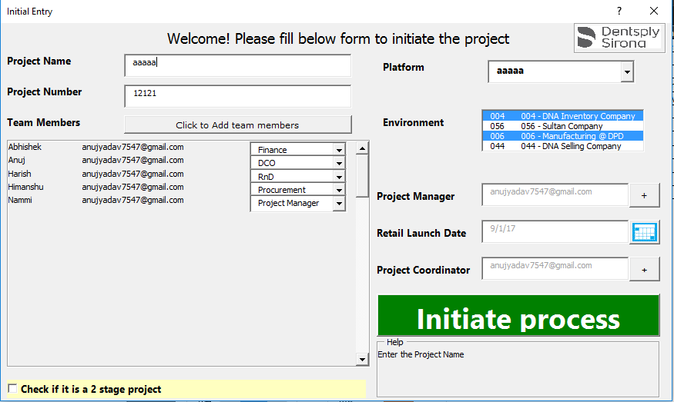
Project Initiation

Slide 8
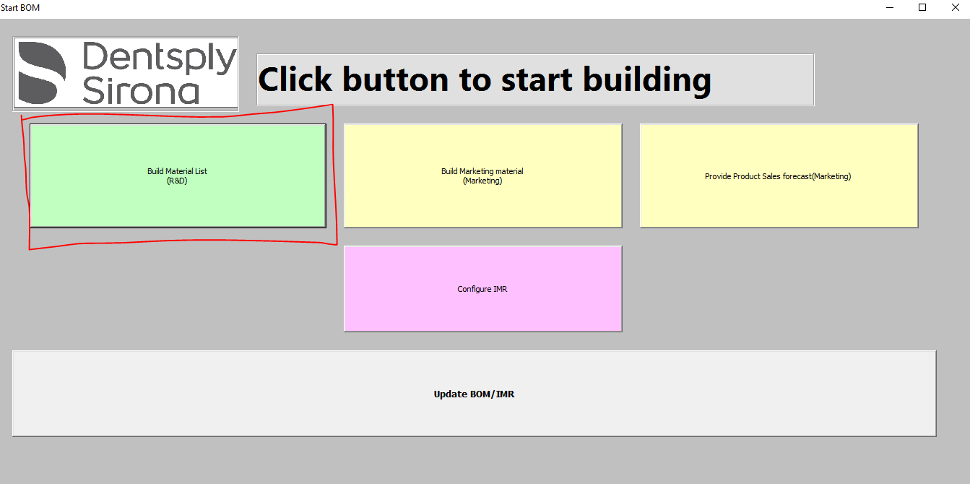

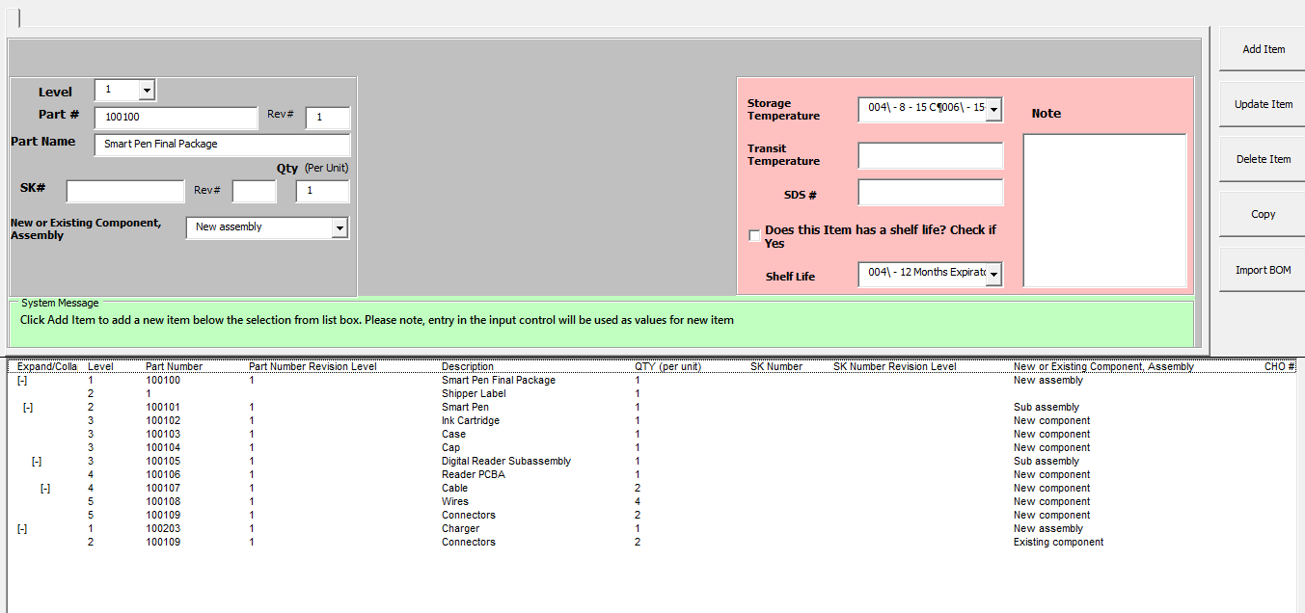
RnD BOM Building

Slide 9
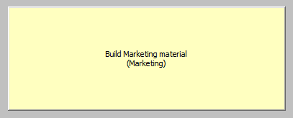
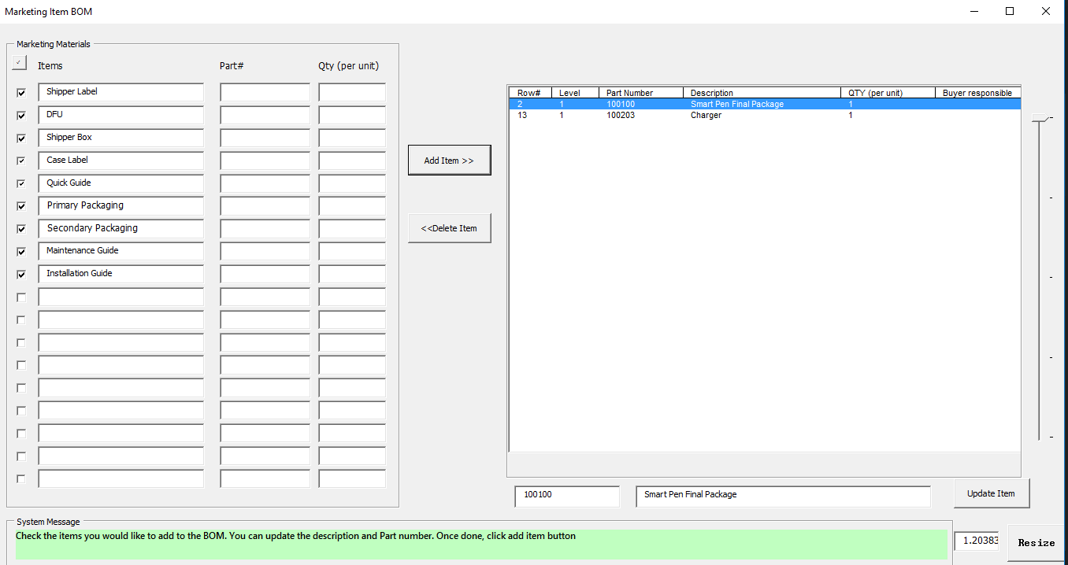
Marketing Materials to BOM

Slide 10

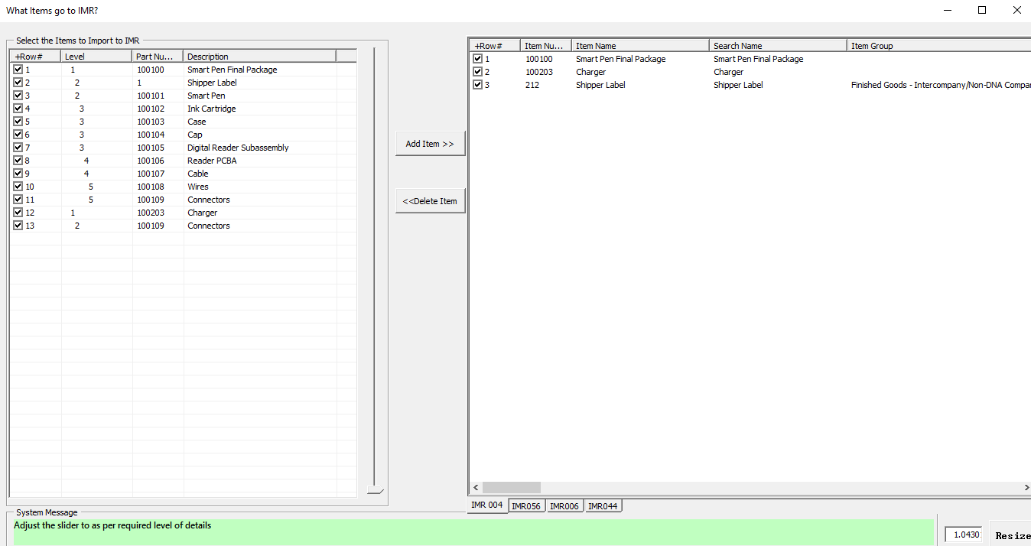
Pulling Items to IMR once deign freeze

Slide 11
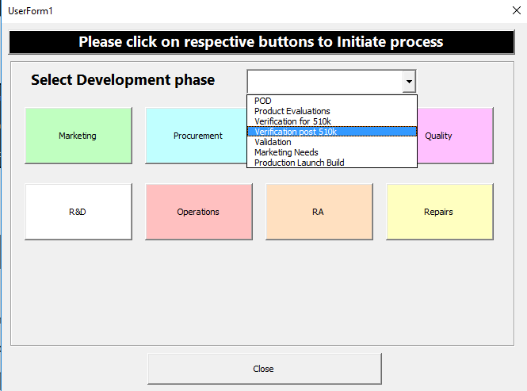
This is a one stop from for all the users to begin there inputs

Slide 12
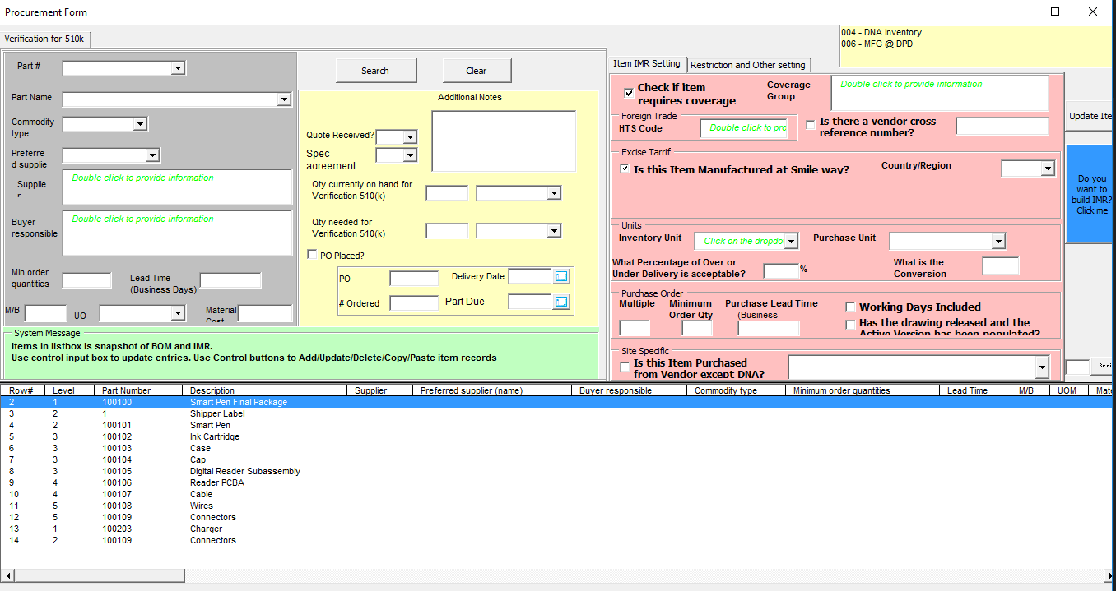
Procurement team would have one window to update all of its items

Slide 13
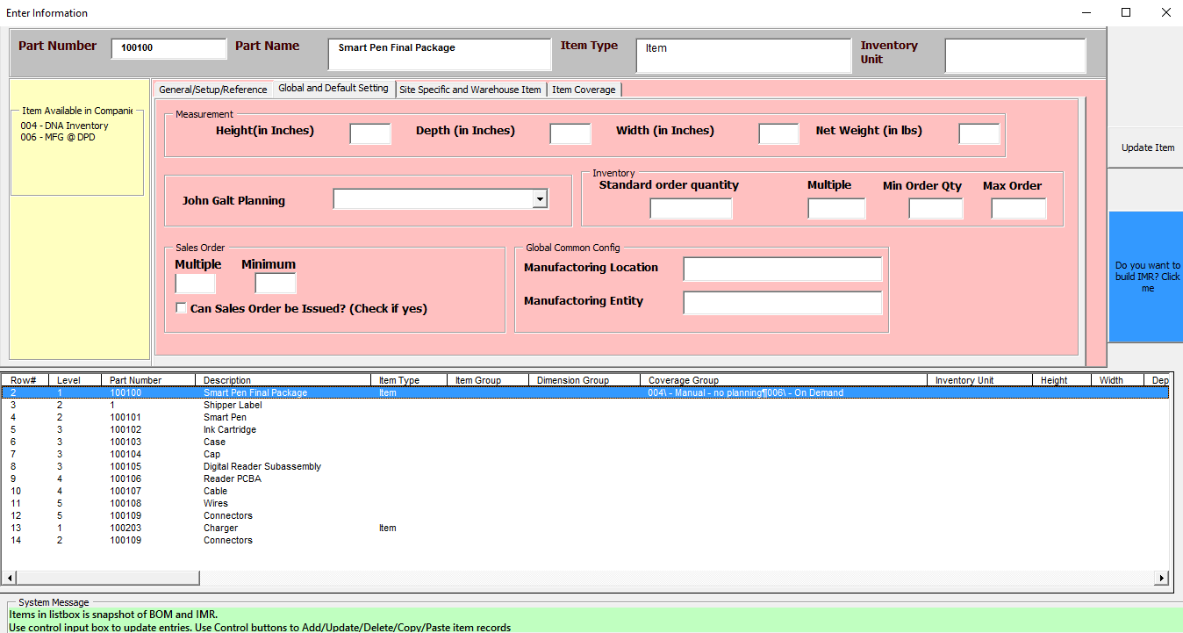
Operations team would have one window to update all of its items

Slide 14
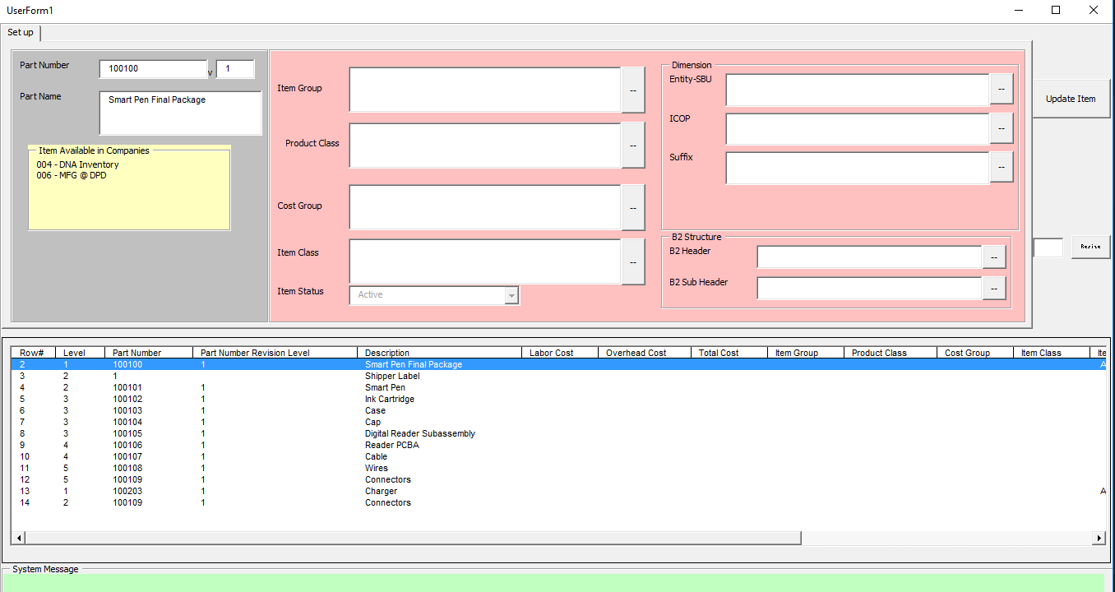
Finance team would have one window to update all of its items

Slide 15
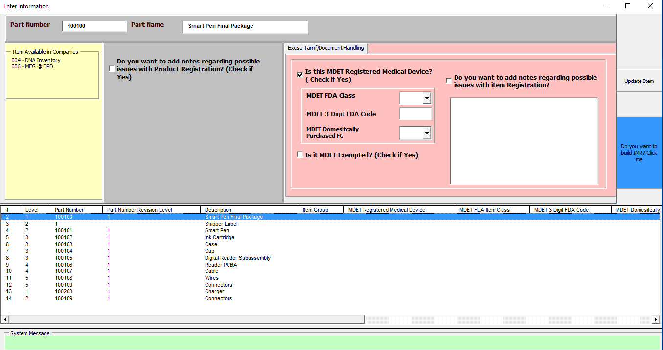
Regulatory team to provide their inputs

Slide 16
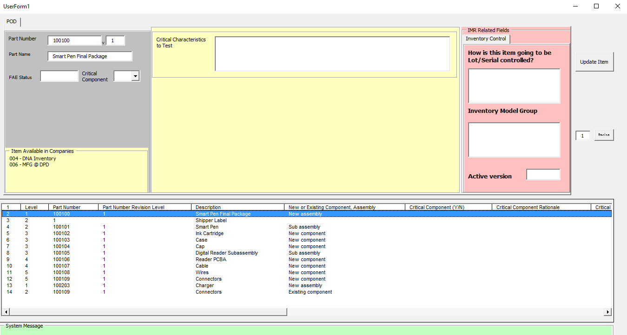
Quality assurance team to provide inputs for qty needed for procurement

Slide 17
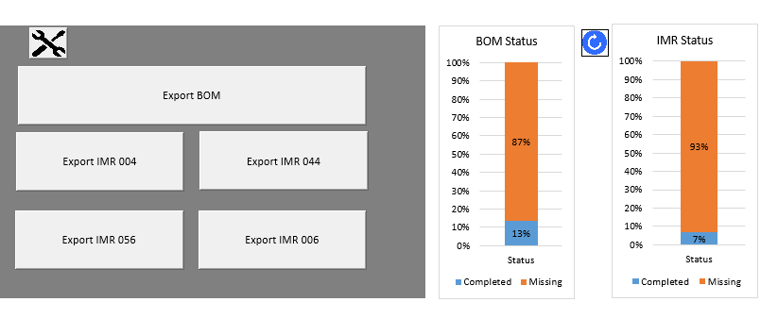
Reporting capability for project managers

Slide 18
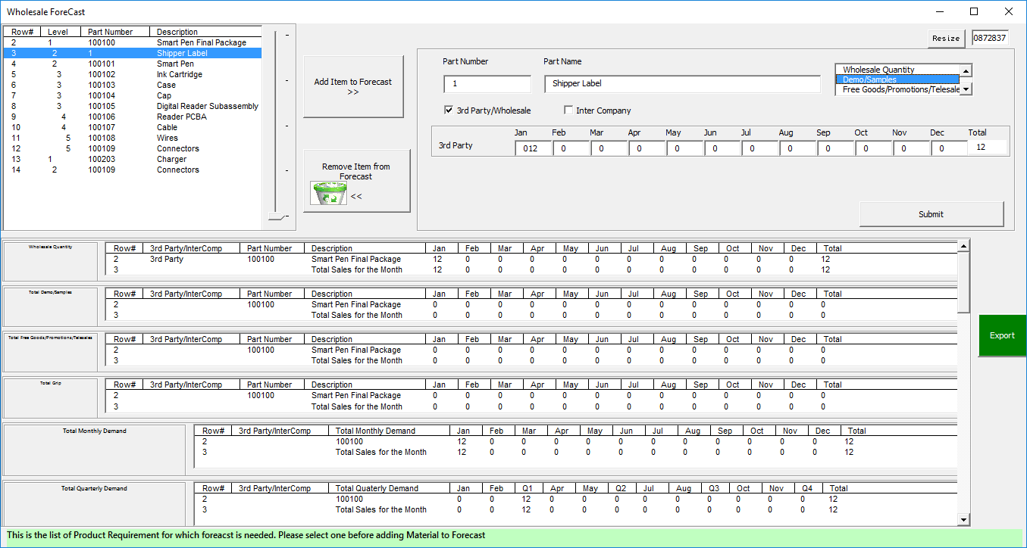
Form to capture marketing forecast

